Slide 1
Lycée Technique de Bonnevoie Luxembourg

Slide 2
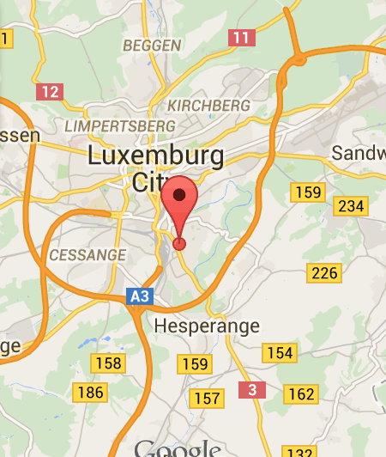
Location
Adress :
LTB
119, rue du cimetière
L-1338 Luxembourg
In the south of Luxembourg City

Slide 3
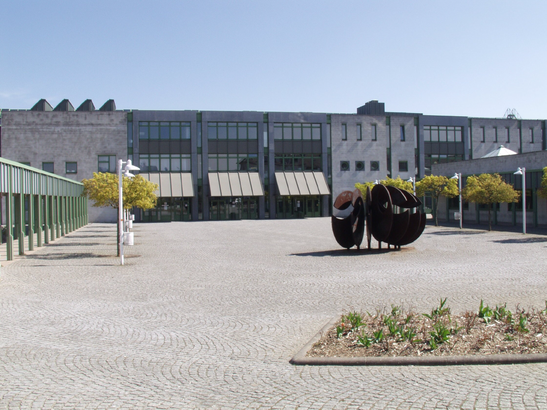
Data
Since 1983
Technical secondary school
230 teachers
50 employees (administration &
technical service)
2048 pupils
> 7 nationalities

Slide 4
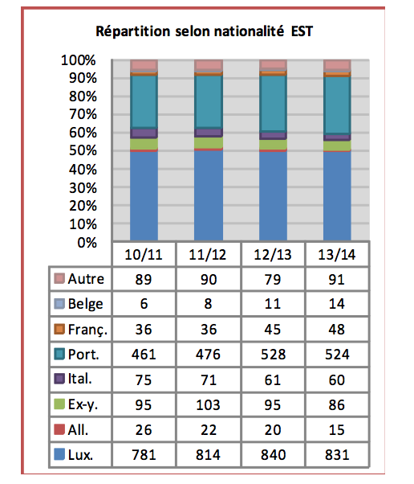
Nationalities
Currently we have
2050 pupils registered
coming from
49 different countries
(50% natives)

Slide 5
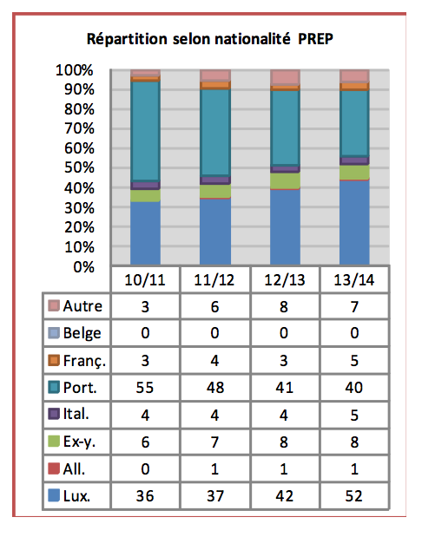
Nationalities preparatory courses
Currently we have
150 pupils
in the preparatory stream
coming from
18 different countries

Slide 6
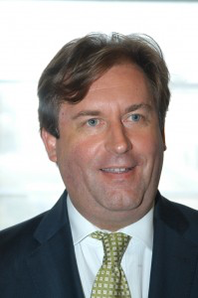
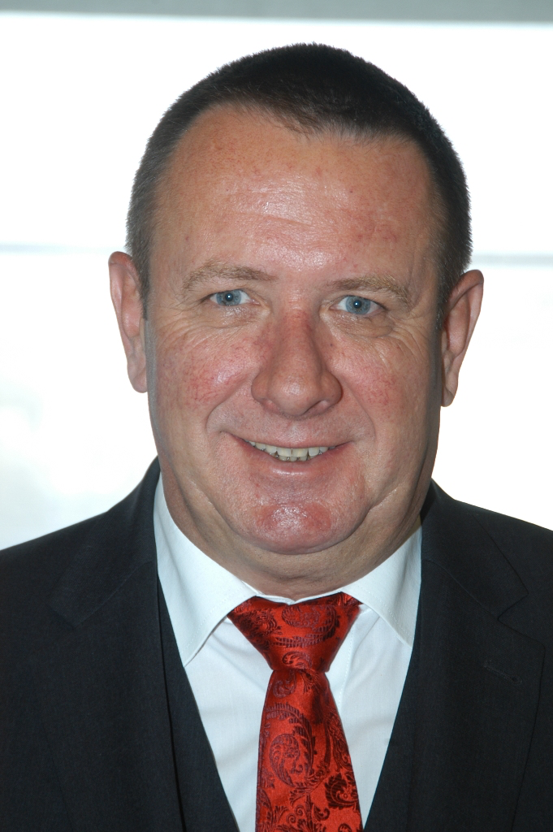
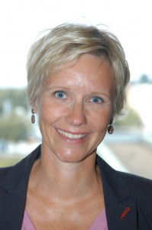
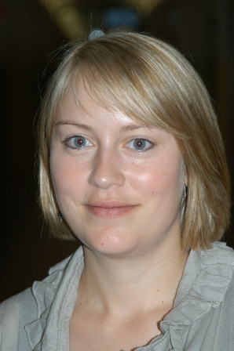
Management
Jean-Marie
WIRTGEN
Headmaster
Overall coordination
Eugène
THILL
Assistant Headmaster
Preparatory stream
Carole
THEISEN
Assistant Headmaster
Vocational training
Tessy
PETRO
Assistant Headmaster
Lower education

Slide 7
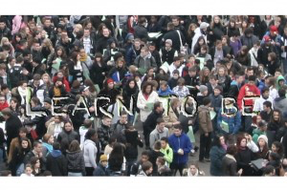
Guiding principles (I/II)
LEARN TO BE
The pupils are
at the centre of all
our concerns

Slide 8
Guiding principles (II/II)
LTB :
One community
An institution of challenge and individual encouragement
A learning and teaching institution
An institution of cooperation

Slide 9
Technical secondary school in Luxembourg General structure

Slide 10
Educational provision (I/III)
Lower classes (pupils aged 12-14):
2 regimes :
Lower secondary education
Duration: 3 years
Preparatory courses
Duration: 3 years

Slide 11
Educational provision (II/III)
Higher classes (pupils aged > 15):
3 regimes | duration | sections | diploma
Technical regime | 4 years | Engineering Trade and management Social sciences | technical secondary school leaving diploma
Technician’s regime | 4 years | Trade and management | technician’s diploma
Vocational training | 3 years | Gastronomy Industry Health Fashion Craft | Vocational aptitude diploma

Slide 12
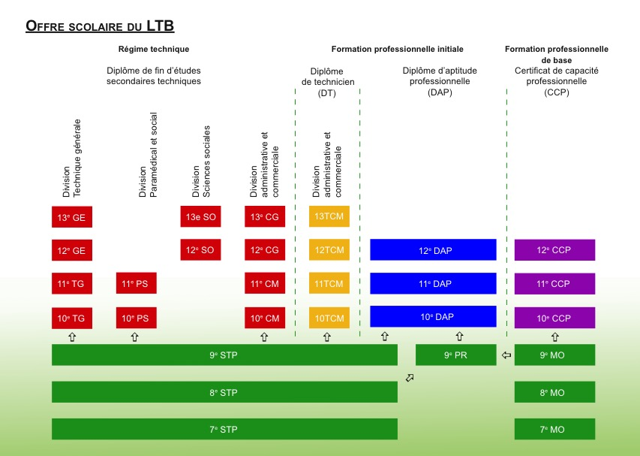
Educational provision – OVERVIEW (III/III)

Slide 13
Preparatory courses
7th, 8th and 9th modular → for students who did not obtain the required level of competencies in primary education
Aims
complete the students’ general education in French, German and
Mathematics
- understand which trade matches the students’ interests and talents
provide preparation for working life, an apprenticeship as well as the lower
stream of the technique system
Organisation
- students advance at their own pace in competence-based modules
subjects: German, French, Mathematics, General Culture, Physical
Education and sport
practical classes: cookery, woodwork, metalwork, pottery and ceramics
work experience in year 9
most subjects are taught in German

Slide 14
Preparatory Courses
Our aims and values:
Conceive our school as a place to learn AND to live
Encourage the personal development of our pupils
Improve the individual support for every pupil
Further the access to culture
Facilitate the transition from school to working life

Slide 15
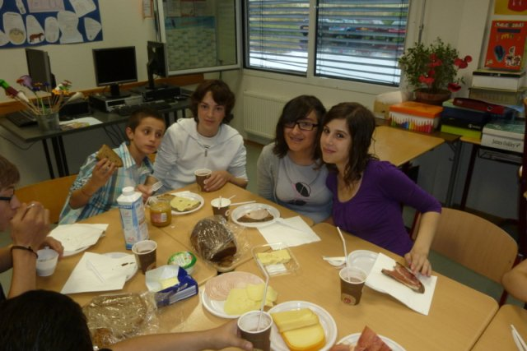
Preparatory Courses
Pedagogical concept I:
One teaching team & one class for 2-3 years
Teamwork between parallel classes
Youth workers in the classes
Democratic round table

Slide 16
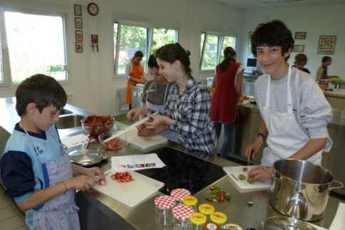
Preparatory Courses
Pedagogical concept II:
Maximum of lessons for the form teacher
Interdisciplinary teaching
Tutoring and homework support
Workshops (metal, wood, cooking, ceramics)

Slide 17
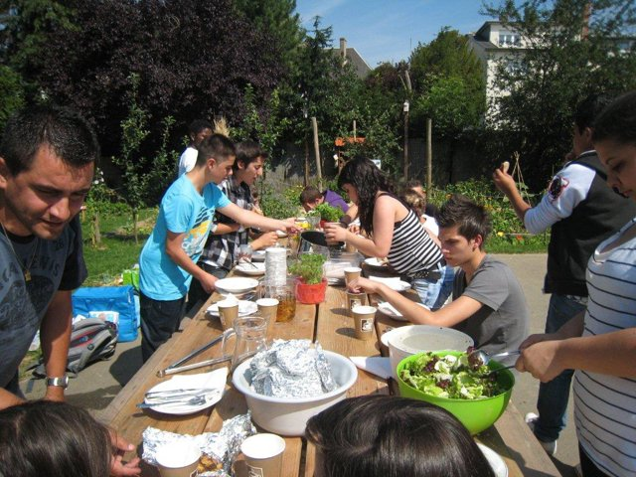
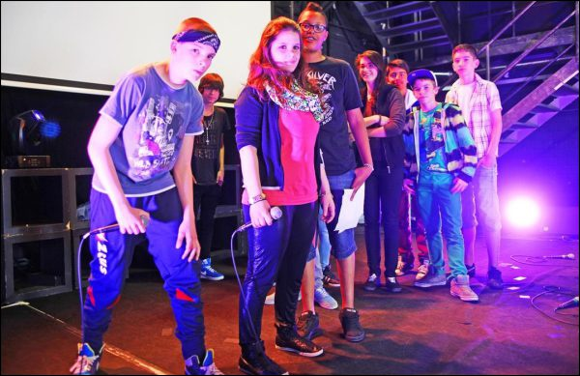
Preparatory Courses
Pedagogical concept III:
Field trips & occasional visits
« Cooltour » – cultural activities
School garden
Extracurricular activities (music, theatre, sports, writing, radio, cooking, tailoring, dance, graffiti…)

