Slide 1
HATSALA CLASSICAL SCHOOL, KUOPIO, FINLAND

Slide 2
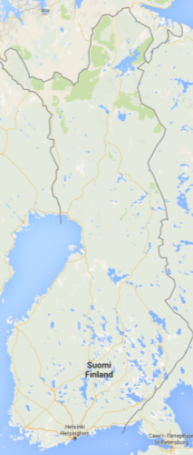
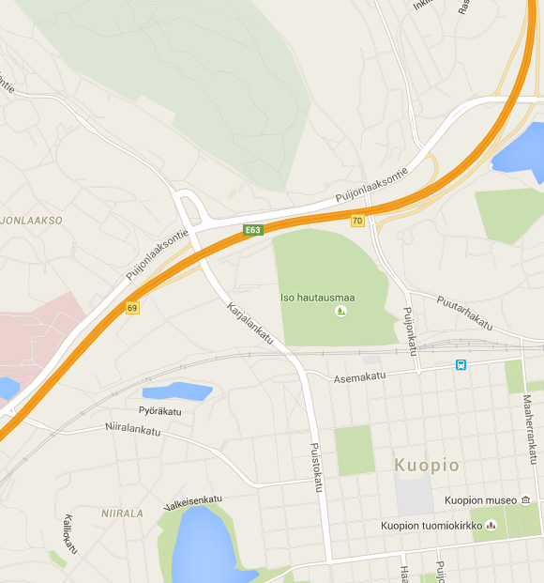
Close to the city, close to the nature
Hatsala Classical School is a lower secondary school in Kuopio, Finland.
It is located close to the city centre but we still have a lot of nature around us.
There are good links to many sporting facilities such as the swimming hall, baseball stadium, Kuopio hall and the Puijo recreation area.
Puijo recreation area
Kuopio
Hatsala Classical School
Map images © Google Maps
City Centre

Slide 3
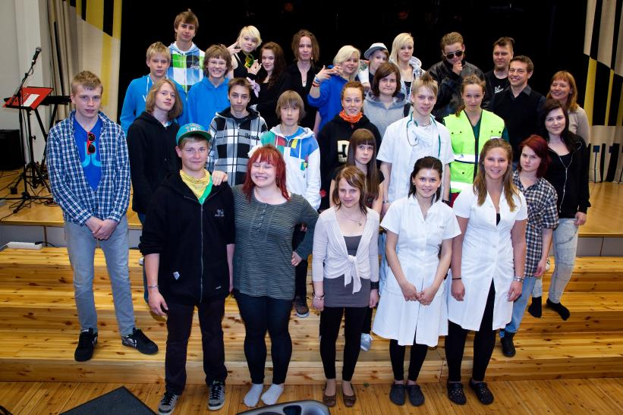
Pupils & Staff
Our school has 650 pupils aged 13-16 in grades 7-9.
Class sizes average between 20-24 pupils.
There are approximately 50 teachers and 5 school assistants.
Most of the pupils live in the local area.
Pupils who attend one of the school’s specialized streams may come from anywhere in the Kuopio area.

Slide 4
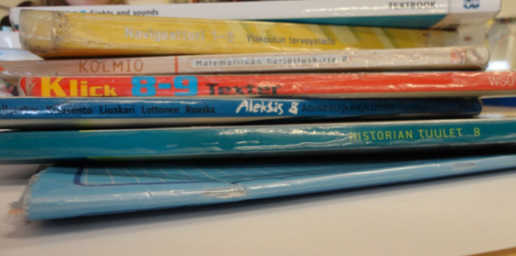
School system
We don’t use school uniforms.
We call our teachers by their first name.
We have free school food every day.
We don’t have to pay for textbooks or notebooks.
Schools in Finland are open five days a week
Lessons at Hatsala usually last 45 minutes, but sometimes we have double lessons which last 90 minutes

Slide 5
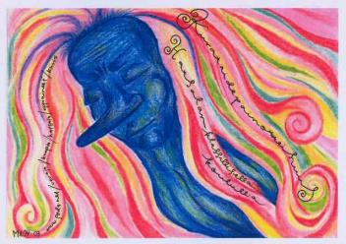
Subjects
The compulsory core subjects are:
Maths
Finnish language and literature
Physics & chemistry
Biology & geography
health education
History & social studies
religious education
physical education
Student guidance
English
Swedish
Optional subjects
P.E.
Languages (French, German or Russian)
Drama
Music
Maths
Physics & chemistry
Home economics
IT
Art
Woodwork
Textiles & design
Technology

Slide 6
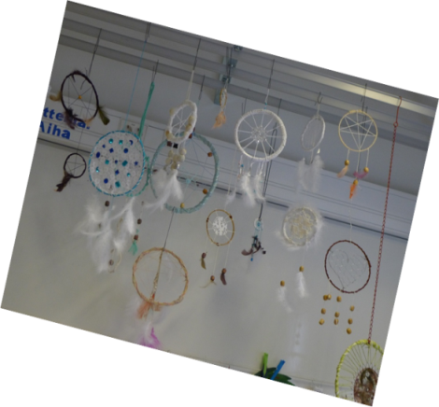
Specialized streams
There are also five specialized streams at Hatsala:
art
Bilingual teaching
Latin
Two separate P.E. streams.
These streams are all selective except for the Latin stream.
Pupils who wish to study in one of the selective streams take an entrance test in their final year of primary school.

Slide 7
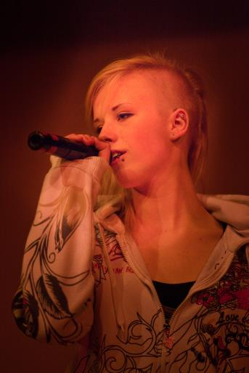
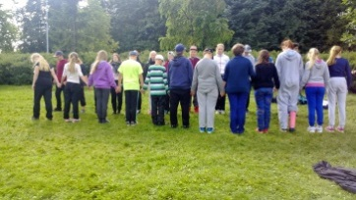
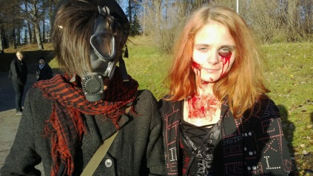
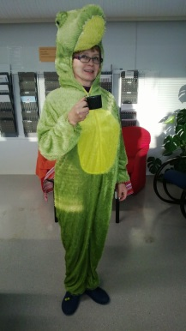
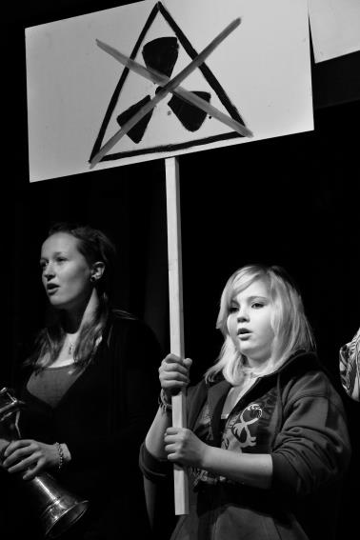
Events
School musicals, festivals and concerts – enable the whole school to come together.
School performances are very popular and pupils (and teachers) are very keen to perform.
Two sports days a year
Seventh grade students have an outdoor activities day held by the student tutors

Slide 8
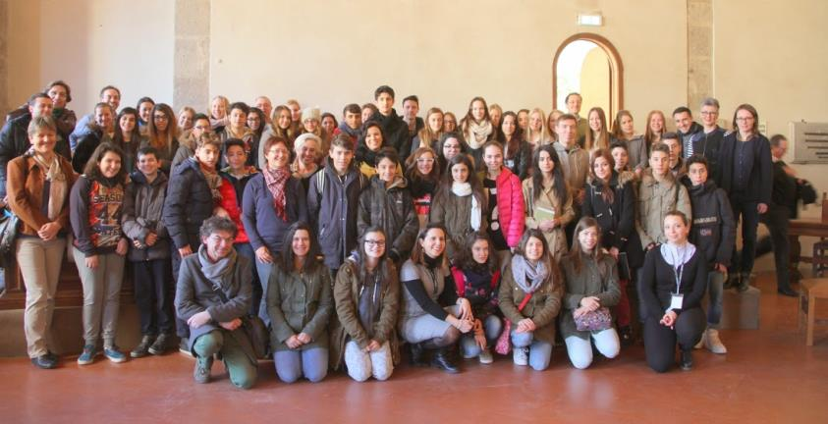
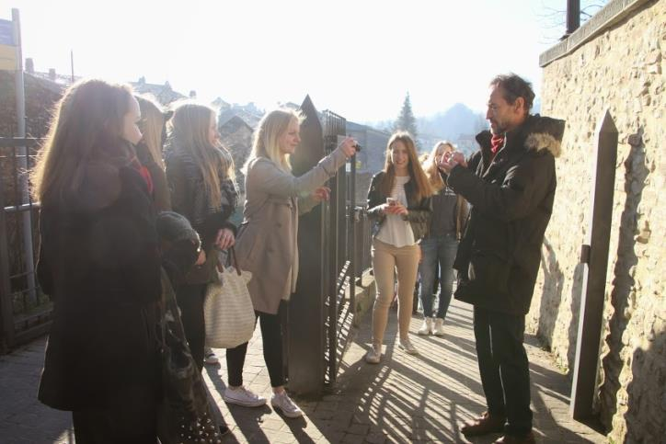
International activities
The international activities play a significant role in the life of Hatsala Classical School.
We are actively connected with various European schools, St. Peter’s School in Panchgani, India and the schools in Shanghai, as the Chinese metropolis is twinned with the city of Kuopio.

Slide 9
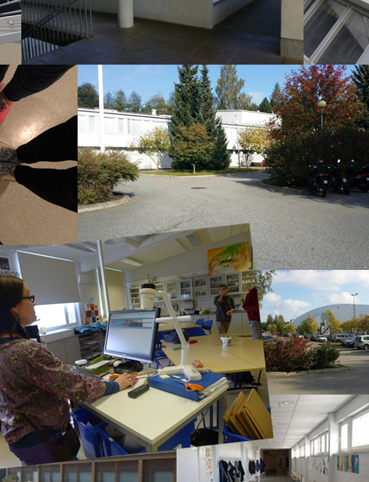
Time for your questions. Thank you for paying attention!

